Slide 1


Titolo presentazione sottotitolo
EEG Signal Analysis
During Mental Arithmetic
Milano, XX mese 20XX
Group Number: 17
Mattia Pezzano
Maurizio Tirabassi

Slide 2
Introduction and Experiment Design
Analysis of EEG data to study the differences in brain activity between cognitive engagement and resting conditions
Experiment involving 6 subjects performing serial mental subtraction
Electrodes placed according to the 10-20 International scheme
Brain activity recorded from two phases:
3-minute rest
1-minute work
500 Hz sampling frequency

Slide 3
Material and Methods: Data Preprocessing
The data was provided partially preprocessed:
0.5Hz high-pass
45Hz low-pass
50Hz notch
Trimming the excess of 1000 samples
Extraction of a 45-second window from the middle of the signals:
Approximation for stationarity
Good representative portion for each phase
Removal of the mean from the signals

Slide 4
Material and Methods: Power Spectral Density and Magnitude-Squared Coherence
Magnitude-squared coherence
Computed between each channel for each frequency band
Power spectral density
Welch method with a 10-second Hamming window with 0.1-second overalp
Baseline-normalization of the work signals with respect to the rest signals
Conversion into decibels
Extraction of the power contribution of relevant frequency bands by integration

Slide 5
Results and Discussion: Frequency Band Activation
Central-parietal beta 2 power increase: stress inducing task and high energy involvement
Frontal beta 1 power increase: quiet, focused, introverted concentration and performance increase
Parieto-occipital alpha power increase: cognitive load and working memory task

Slide 6
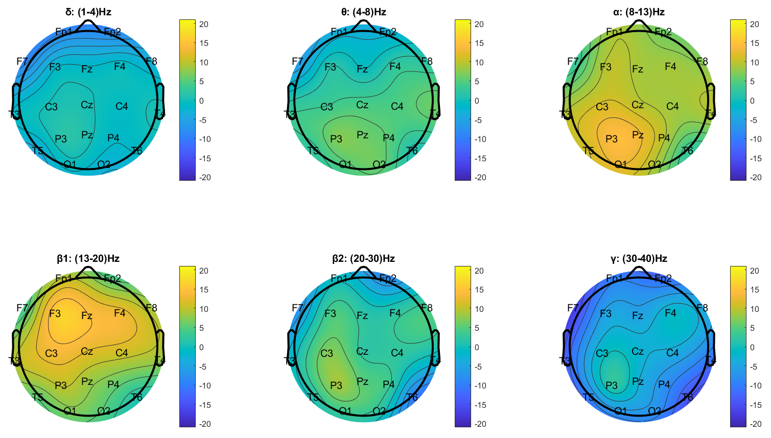
Results and Discussion: Hemispherical Asymmetry in Workload
Asymmetry in frequency band power increase between lobes

Slide 7
Results and Discussion: Coherence Among Channels During Work
High functional connectivity in the frontal, temporal and central regions: brain areas involved in cognitive engagement

